Slide 1
Concurrency

Slide 2
Discussion
Give an example of concurrency in your daily life
Give an example of concurrency for a computer

Slide 3
Discussion
Give an example of concurrency in your daily life
Taking notes while listening to a lecture
Driving while listening to a radio
…
Give an example of concurrency for a computer
Maintaining Internet connection while receiving keyboard input
Playing a movie while receiving emails
…

Slide 4
Why concurrency?
Multi-Task
Higher resource utilization
Reduced waiting time

Slide 5
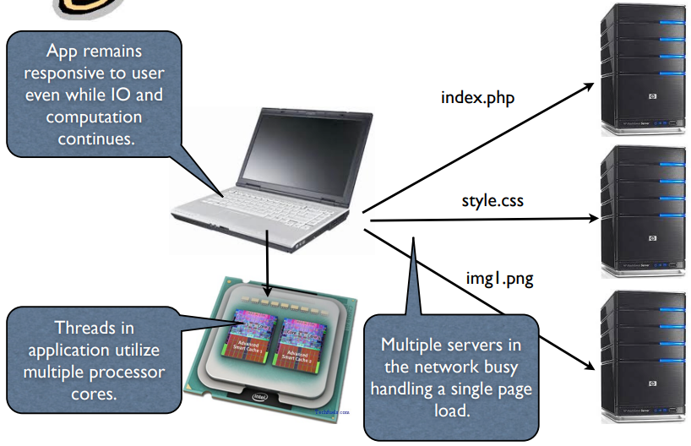
Client Concurrency
Concurrency: Client’s perspective
opportunity for parallelization
within a client
multiple servers

Slide 6
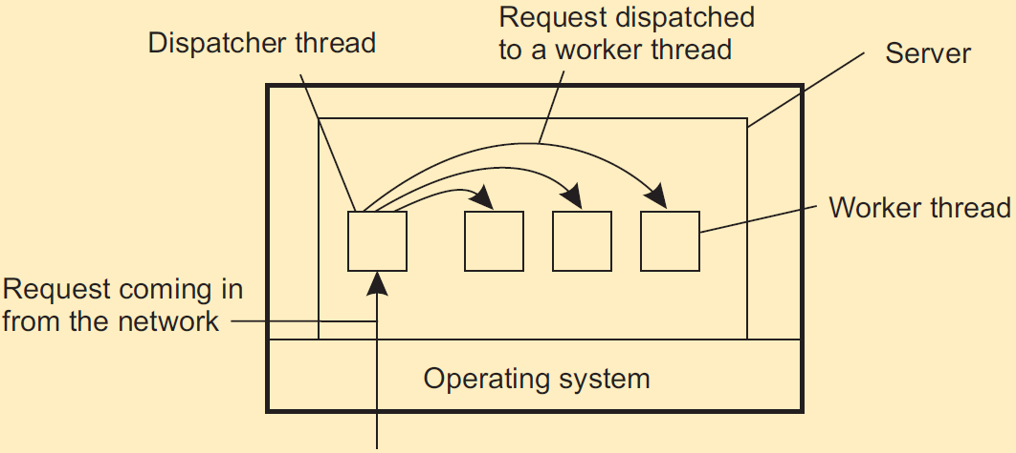
Server Concurrency
Concurrency: server’s perspective
exploits parallelism
higher utilization (efficient dispatch)

Slide 7
Basic Concepts
Processor vs. Core
Process vs. Thread
Parallelism vs. Concurrency
More detail
Only one page
https://docs.oracle.com/javase/tutorial/essential/concurrency/procthread.html

Slide 8
Processor vs. Core
A CPU, or Central Processing Unit, is what is typically referred to as a processor.
One processor can have multiple cores.
Modern computer can have multiple processors.

Slide 9
Process vs. Thread (1)
Process
A software processor in whose context one or more threads may be executed.
Every process has at least one thread.
Thread
A minimal software processor in whose context a series of instructions can be executed.
A Thread is sometimes called lightweight process.

Slide 10
Process vs. Thread (2)
Process switching is generally (somewhat) more expensive as it involves getting the OS in the loop.
Creating and destroying threads is much cheaper than doing so for processes.

Slide 11
Why use thread?
Avoid needless blocking
A single-threaded process will block when doing I/O; in a multi-threaded process, the operating system can switch the CPU to another thread in that process.
Exploit parallelism
the threads in a multi-threaded process can be scheduled to run in parallel on a multiprocessor or multicore processor.
Avoid process switching
structure large applications not as a collection of processes, but through multiple threads.

Slide 12
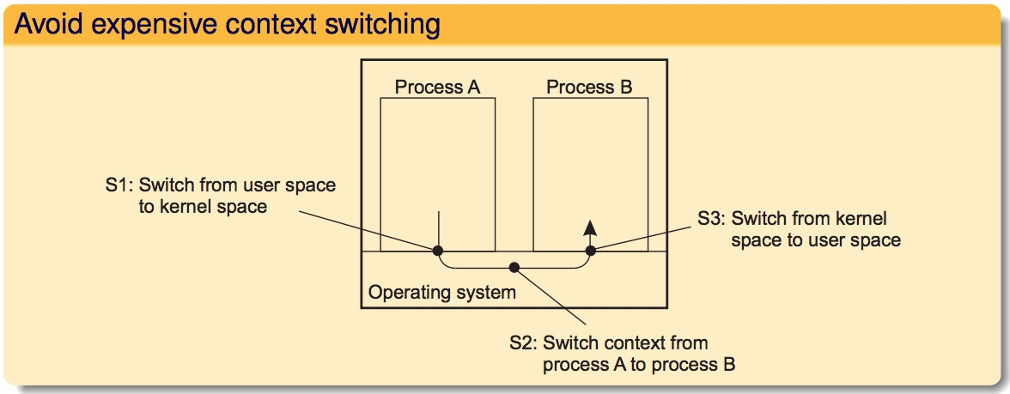
Avoid process switching

Slide 13
Threading: Pros & Cons
Pro:
Better performance
Parallelism
...
Con:
Concurrent update to shared data requires programmer to explicitly synchronize.

Slide 14
Concurrency vs. Parallelism
Concurrency is not parallelism!
Concurrency
Two tasks can start, run, and complete in overlapping time periods.
Though tasks run looks like simultaneously, but essentially they MAY not.
Takes advantage of CPU time-slicing
Parallelism
when tasks literally run at the same time, e.g. on a multi-core processor or multiple processors.
Assign one processor/core to each task
Needs hardware support, e.g., a multi-core processor or multiple processors

Slide 15
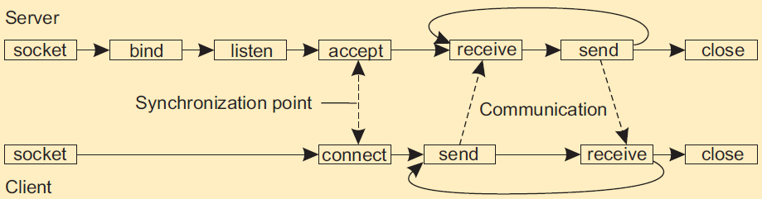
Revisit the discussion question
Socket generally works in the following way as shown in the figure.
If we actually adopt this working flow of socket on a real server receiving clients’ requests, what is the problem?
Can you propose an idea to solve the problem?
Notes:
One core vs. multi-core: the difference

Slide 16
Critical section (1)
Thread #1
bal = bal + deposit;
bal = bal * 2;
Thread #2
bal = bal * 2;
bal = bal + deposit;
bal=100
deposit=50
Now assume Thread #1 executes before Thread #2

Slide 17
Critical section (2)
Case 1:
bal = bal + deposit = 100 + 50 = 150 //Thread #1
bal = bal * 2 = 300 //Thread #1
bal = bal * 2 = 600 //Thread #2
bal = bal + deposit = 600 + 50 = 650 //Thread #2
Case 2:
bal = bal + deposit = 100 + 50 = 150 //Thread #1
bal = bal * 2 = 300 //Thread #2
bal = bal + deposit = 300 + 50 = 350 //Thread #2
bal = bal * 2 = 700 //Thread #1

Slide 18
Critical section (3)
Assume we have n threads:
threads share data
each thread has a “critical section”
if one thread is in the critical section, no other thread can be in its critical section.

Slide 19
Solution to critical section
A solution must satisfy the following:
mutual exclusion: If a process/thread is executing in its critical section, then no other processes/threads can be executing in their critical sections.
progress: If no process/thread is executing in its critical section and there exist some processes/threads that wish to enter their critical section, then the selection of the processes/threads that will enter the critical section next, cannot be postponed indefinitely.
bounded waiting: no process/thread can be kept waiting forever to enter its CS.

Slide 20
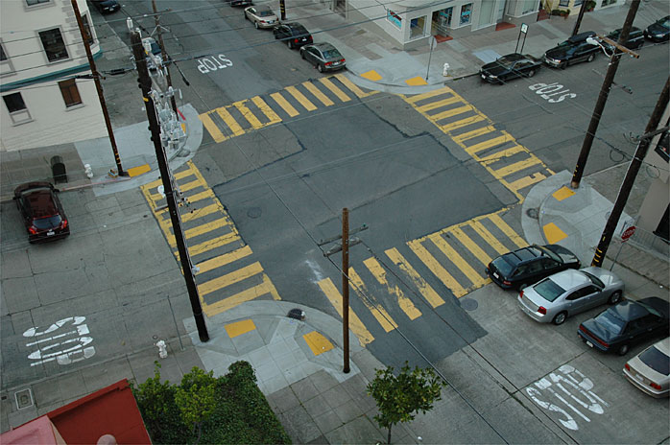




Mutual Exclusion: Traffic Analogy
If process P_{i} is executing in its critical section, then no other processes can be executing in their critical sections
3
1
4
2

Slide 21
Mutual Exclusion: Traffic Analogy
If process P_{i} is executing in its critical section, then no other processes can be executing in their critical sections
Only one car can be in the square area between the stop signs at a given time
3
1
2
4

Slide 22
Progress: Traffic Analogy
If no process is executing in its critical section and there exist some processes that wish to enter their critical section, then the selection of the processes that will enter the critical section next cannot be postponed indefinitely

Slide 23
Progress: Traffic Analogy
If no process is executing in its critical section and there exist some processes that wish to enter their critical section, then the selection of the processes that will enter the critical section next cannot be postponed indefinitely
If the square is empty and there is some car, it will get to cross (no starvation)

Slide 24
Bounded Waiting: Traffic Analogy
no process/thread can be kept waiting forever to enter its CS.
1
3
Any car has to wait at most for 3 others to pass after it
stops (fairness)
2
4

Slide 25
A more general example
Bank account
Initial balance: $500
Users A and B
A makes $100 deposit
B requests $100 withdrawal
Discussion:
Can you give an example that shows the final balance is NOT $500? Is there any solution you can think of to solve the problem?

Slide 26
Banking Example
Initial Balance: $500
Time
A makes $100 deposit
Get current balance of $500
balance = 500 + 100 = 600
Write new balance back to disk thus on disk = $600
B requests $100 withdrawal
Get current balance of $500
balance = 500 - 100 = 400
Write new balance back to disk thus on disk = $400
Final Answer?

Slide 27
Mutual exclusion
Problem
A number of processes in a distributed system want exclusive access to some resources.
Discussion
Can you propose some solutions to achieve mutual exclusion for multiple processes?
Please go to
PollEv.com/cisgvsu429

Slide 28
Mutual exclusion
Problem
A number of processes in a distributed system want exclusive access to some resources.
Basic solutions
Permission-based: A process wanting to enter its critical section, or access a resource, needs permission.
Token-based: A token is passed between processes. The one who has the token may proceed in its critical section, or pass it on when not interested.

Slide 29
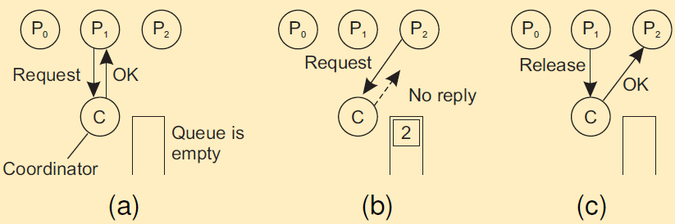
Mutual Exclusion: Permission-based
(a) Process P1 asks the coordinator for permission to access a shared resource. Permission is granted.
(b) Process P2 then asks permission to access the same resource. The coordinator does not reply.
(c) When P1 releases the resource, it tells the coordinator, which then replies to P2.

Slide 30
Lock
Locking: deny other users’ accesses to data while one user’s updates are being processed
Mechanism for enforcing limits on access to the object
If the access to the object is locked, other users have to wait until it’s unlocked

Slide 31
Banking Example (Permission-based: Lock)
Initial Balance: $500
Time
A makes $100 deposit
Request and get AcctLock
Get current balance of $500 from disk
balance = 500 + 100 = 600
Write back balance = $600
Release AcctLock
B requests $100 withdrawal
Request AcctLock
Wait(AcctLock)
Get AcctLock
Read balance = 600
balance = 600 - 100 = 500
Write back $500

Slide 32
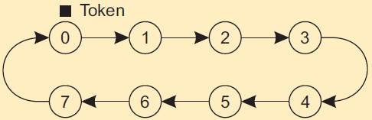
Mutual exclusion: Token-based
Essence
Organize processes in a logical ring, and let a token be passed between them.
The one that holds the token is allowed to enter the critical region (if it wants to).
An overlay network constructed as a logical ring with a circulating token

Slide 33
How to elect a coordinator
Principle
An algorithm requires that some process acts as a coordinator. The question is how to select this special process dynamically.
Note
In many systems the coordinator is chosen by hand. This leads to centralized solutions (e.g., single point of failure).
Basic assumptions:
All processes have unique IDs.
All processes know IDs of all processes in the system (but not if they are up or down)
Election means identifying the process with the highest ID that is up

Slide 34
Election by bullying (1)
Consider N processes {P₀, P₁, …, P_{N-1}} and let id(P_{k} ) = k. When a process P_{k} notices that the coordinator is no longer responding to requests, it initiates an election:
P_{k} sends an ELECTION message to all processes with higher identifiers: P_{k+1}, P_{k+2}, …, P_{N-1}.
If no one responds, P_{k} wins the election and becomes coordinator.
If one of the higher-ups answers, it takes over and P_{k}’s job is done.

Slide 35
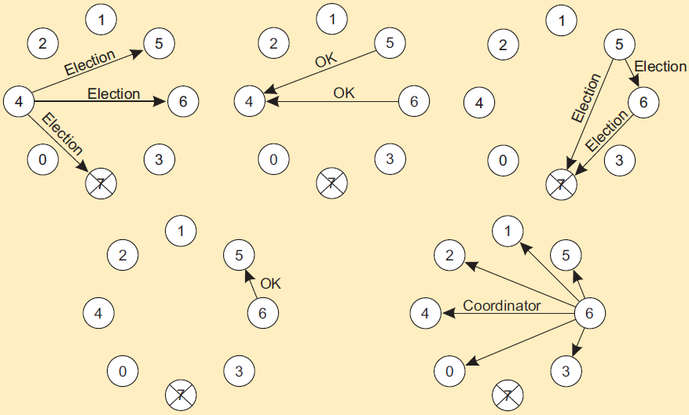
Election by bullying (2)

Slide 36
Election in a ring (1)
Process priority is obtained by organizing processes into a (logical) ring. Process with the highest priority should be elected as coordinator.
Any process can start an election by sending an election message to its successor. If a successor is down, the message is passed on to the next successor.
If a message is passed on, the sender adds itself to the list. When it gets back to the initiator, everyone had a chance to make its presence known.
The initiator sends a coordinator message around the ring containing a list of all living processes. The one with the highest priority is elected as coordinator.

Slide 37
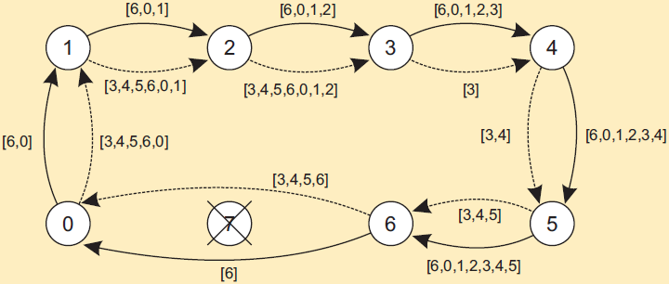
Election in a ring (2)

Slide 38
Discussion
Consider the following scenario:
Both Job A and B need resource C and D to finish
Job A needs to process resource C first, then looks for resource D
Job B needs to process resource D first, then looks for resource C
Now, Job A and B arrive roughly at the same time.
Questions
What could be the problem in this scenario?
Is there any way to solve this problem?
Please go to
PollEv.com/cisgvsu429

Slide 39
Deadlock (1)
When sharing resources, jobs can get into never-ending waits:
A has resource C, needs D
B has resource D, needs C
Job B
Job A
resource C
resource D
Job A arrives, requests C, Gets C; Job B arrives, requests D, Gets D;
Job A finishes C, requests D, denied; Job B finishes D, requests C, denied.

Slide 40
Deadlock (2)
Ensure that the system will never enter a deadlock state – deadlock prevention (e.g., use timestamping or token ring instead of lock)
Allow the system to enter a deadlock state and then recover
detects and breaks any deadlock
By preemption or by killing the job
choose one job to be the victim

Slide 41
Discussion
Can you give a real-life example of deadlock that follows the previous idea?
Please go to
PollEv.com/cisgvsu429

Slide 42
Bridge Crossing Example (deadlock)
Traffic only in one direction
Each section of a bridge can be viewed as a resource
If a deadlock occurs, it can be resolved if one car backs up (preempt resources and rollback)
Several cars may have to be backed up if a deadlock occurs

Slide 43
Discussion
Now, we understand what deadlock is.
How about livelock? Can you give an example of livelock?

Slide 44
Livelock
A livelock is almost similar to a deadlock, except that it occurs when two or more processes continually repeat the same interaction in response to changes in the other processes without doing any useful work. None progressing.

Slide 45
Bridge Crossing Example (livelock)
Traffic only in one direction
Each section of a bridge can be viewed as a resource
If a livelock occurs, both cars back up. So no car can go through.

